Slide 1
Augmented Reality
By Alexie Roy

Slide 2

Augmented Reality (AR)
Augmented Reality is where designers enhances parts of the users’ experience of the physical world with computer-generated input (this ranges from video, sound, graphics, GPS overlays, etc.)
The purpose of AR is to overlay information to the real world for different fields such as healthcare, technology, business, etc.

Slide 3
History of Augmented Reality
1968: The first head-mounted display called “The Sword of Damocles” was created by Ivan Sutherland
1974: Videoplace
1992: Created by Louis Rosenburg, Virtual Fixturesis one of the first functional AR systems
1994: Dancing in Cyberspace
1998: Sportsvision broadcasts the first live NFL game with the virtual 1st & Ten graphic (yellow yard marker).
1999: NASA created a hybrid synthetic visions system of X-38 spacecraft to provide better navigation during test flights.

Slide 4
History of Augmented Reality (Cont.)
2000: ARToolKit was created by Hirokazu Kato to help developers build AR software programs
2003: Sportvision enhanced the 1st & Ten graphic to include the feature on the new Skycam system
2013: MARTA app (Mobile Augmented Reality Technical Assistance)
2014: Google Glass devices was created for immersive experiences
2016: Microsoft shipped wearable AR technology called the HoloLens
2017: IKEA Place app for letting users to preview home décor options

Slide 5
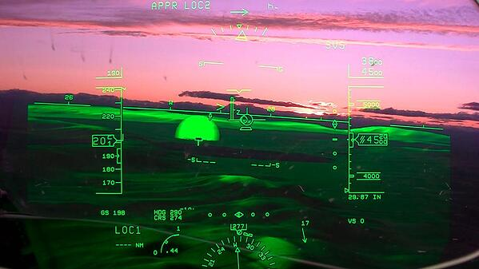
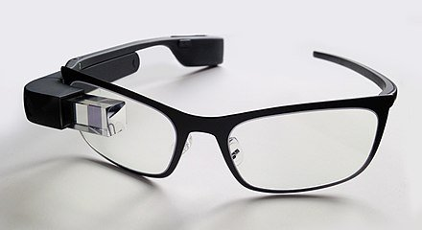
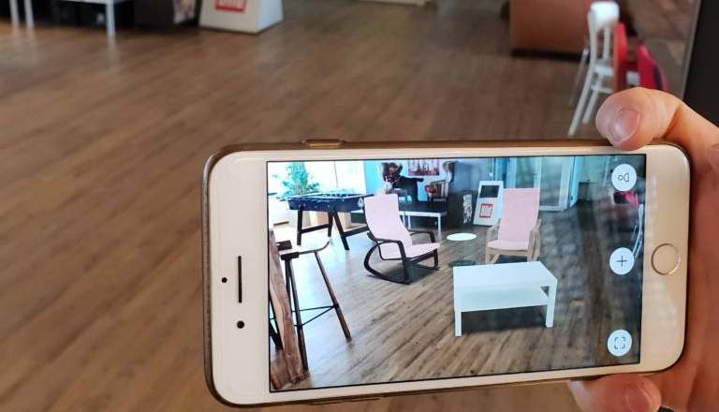
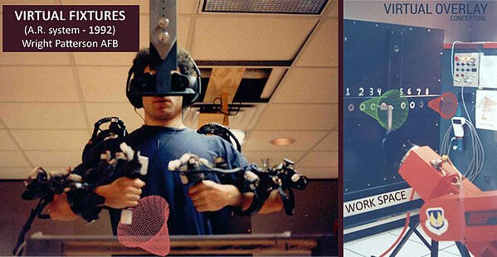
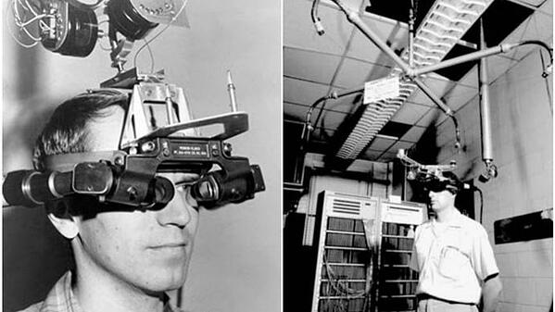
AR technologies

Slide 6
How is Augmented Reality Works
1.) Hardware needed to support the demands of AR is a processor, GPU (Graphic Processing Unit), & sensors (depth sensor, gyroscope, proximity sensor, accelerometer, & light sensor).
2.)The software needed can vary between using ARKit & ARCore in order to let AR experiences have motion tracking, environment understanding, & light estimation.
3.) Application of AR is crucial part of this process due to it allowing the AR applications to run on your smartphone.

Slide 7
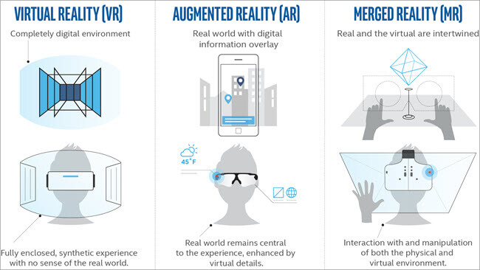
Augmented Reality (AR) vs. Virtual Reality (VR)
AR is based on having a design of digital elements appearing over real-world views which can be limited interactivity between at times.
It uses the existing environment and overlays it with new information
AR platform detects markers (barcode) or user location that triggers the AR animations, which then the AR software will deliver animations to the markers or detected user locations.
VR is based on having an design that creates an immersive experience in which it isolates users from the real world.
Virtual Reality Modeling Language (VRML) experiences create an interactive sequence of audio, animations, videos, and URLs that’s fetched by an app, client, or web browser to simulate virtual environments.

Slide 8
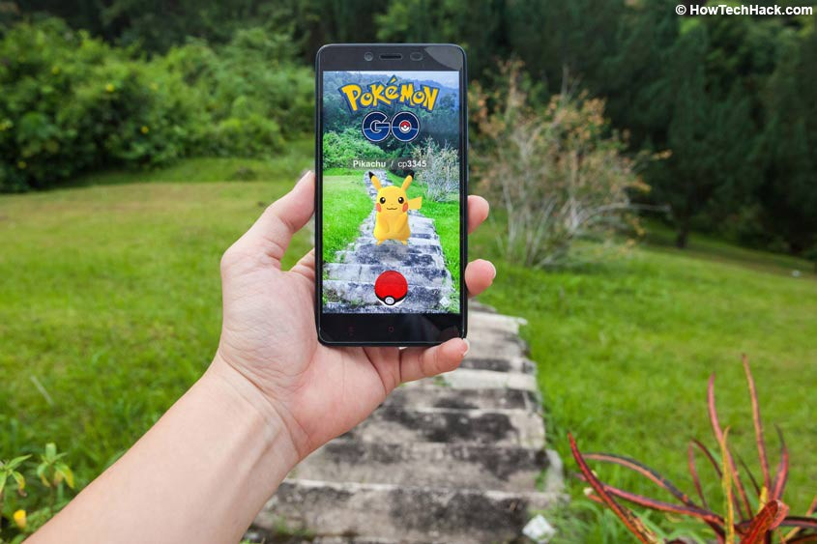
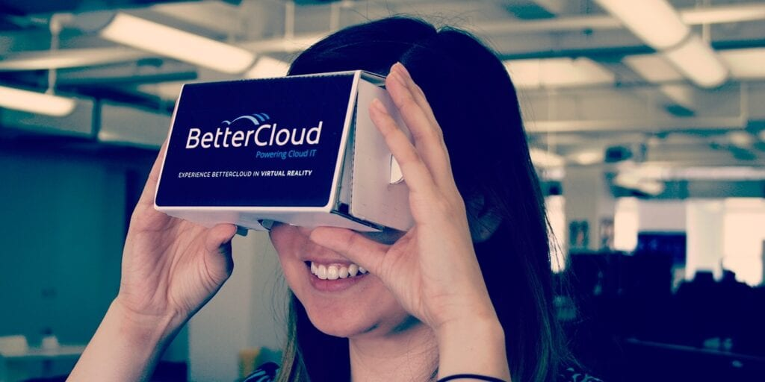
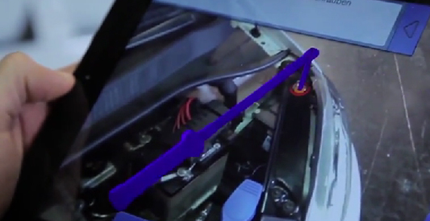
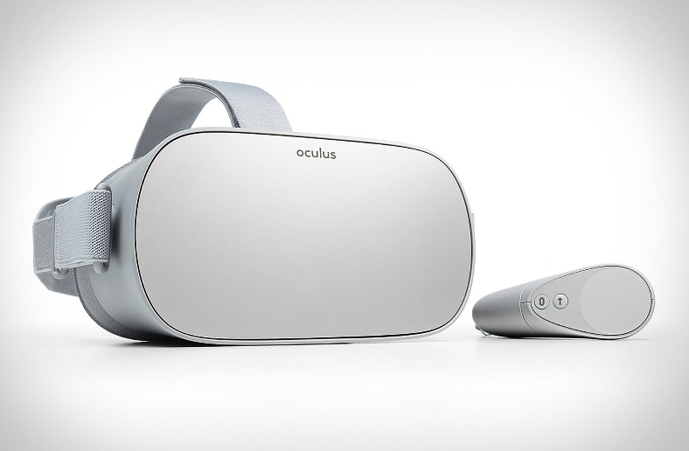
Examples of Augmented Reality vs. Virtual Reality

Slide 9
References
AR Vs VR: Difference Between Augmented Vs Virtual Reality. (2021, March). Software Testing Help. Retrieved April 1, 2021, from https://www.softwaretestinghelp.com/ar-vs-vr-comparison/ #Difference_Between_VR_And_AR
Augmented Reality. (n.d.). Interaction Design Foundation. Retrieved April 2, 2021, from https://www.interaction-design.org/literature/topics/ augmented-reality#:~:text=Augmented%20reality%20%28AR%29%20is%20an%20experience%2 0where%20designers,to%20changes%20in%20the%20user%E2%80%99s%20environment%2C%20ty pically%20movement.
Kothavala, U. (2018, June 2). How Augmented Reality is Being Implemented in the Real World. Entrepeneur India. Retrieved April 2, 2021, from https://www.entrepreneur.com/article/ 314403#:~:text=Augmented%20reality%20apps%20are%20usually%20written%20using%20spe cial,as%20cars%2C%20the%20inside%20of%20buildings%2C%20and%20machinery.
Poetker, B. (2019, August). A Brief History of Augmented Reality (+Future Trends & Impact). Learning Hub. Retrieved April 1, 2021, from https://learn.g2.com/ history-of-augmented-reality#:~:text=Augmented%20reality%20technology%20was%20inv ented%20in%201968%2C%20with,a%20growing%20list%20of%20use%20cases%20for%20AR.

Slide 10
Class Activity
I want everyone in class to be able to find examples of Augmented Reality that can be used in…..
Health Care
Education
Companies
Gaming
Design

